Slide 1

Unit 11

Slide 2

Unit 11
Sad movies make me cry.

Slide 3



Slide 4


Complete the following sentences.
1. 他父亲为了赚钱，从早忙到晚。
His father is busy all day in order to
___________.
2. 看足球赛使我疯狂。
___________________________________.
make money
Watching football games makes me crazy

Slide 5
3. 轻柔的音乐使约翰昏昏欲睡。
The soft music ______ John ______.
4. 红色使人们吃得更快些。
The color red ______ people ______ faster.
5. 长时间等她让我很生气。
Waiting a long time for her _________
______.
makes
sleepy
makes
eat
makes me
angry

Slide 6


1. To listen for specific information about The Shirt of Happy Man (Part Ⅱ)
2. To discuss the meaning of happiness

Slide 7

Answer the questions.
1. Why does power not make the prime minister happy?
He’s always worried about losing his power, and many people are trying to take his position.

Slide 8
2. Why does money not make the banker happy?
3. Why does fame not make the singer happy?
He’s always worried about losing his money, and someone tries to steal his money every day.
He’s always worried about being followed by others, so he cannot be free.

Slide 9

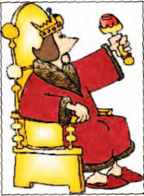
What’s the ending of the story about the unhappy king?

Slide 10


Look at the possible endings to the story about the unhappy king. Do you think any of these is the
right one? If so, which one?
1a

Slide 11
a. The general cannot find a happy person and the king remains unhappy forever.
b. The general finds a happy person with power and money.
c. The general realizes he is a happy person and gives his shirt to the king to wear.
d. The king suddenly becomes happy without the shirt of a happy person.

Slide 12
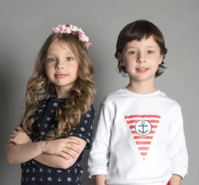
What are some other possible endings to the story? Discuss your ideas with your partner.
1b
The general found a poor man. The man was very happy.
The poor man gave his shirt to the general.

Slide 13


Listen to The Shirt of a Happy Man (Part II) and check (✔) the things that happened in the rest of the story.
1c

Slide 14

_____ The general searched for three days and found a happy person.
_____ The general could not find a happy person.
_____ The general saw a poor man on the street.
_____ The poor man was a happy man.
_____ The poor man gave the general his shirt.
✔
✔

Slide 15
1d
Listen again. Answer the questions.
1. How long did it take the general to find the happy man?
2. What was the poor man doing on the street?
It took the general two days to find the happy man.
He was eating some food with his hands and singing happily to himself.

Slide 16
3. What made the poor man so happy even though he had no power, money or fame?
4. Do you think the general will return to the king with the poor man’s shirt? Why or why not?
He had everything he wanted and didn’t want what he couldn’t have.
No, because the poor man did not have a shirt.

Slide 17

Listen for the third time and complete the conversation.
The general searched and searched but couldn’t find anyone. _____________ everyone had their own problems, and no one was truly happy. Two days passed. Just as he ___________________, he saw a poor man on the street. He was eating with his hands and _______________________. The general went up to him.
It seemed that
was about to give up
singing happily to himself

Slide 18
General: Hello! I’m the king’s top general.
Man: Hi, General. What can I do for you today?
General: I ________________ just now, and you _______ very happy.
Man: That’s because I am happy.
General: But I don’t understand. ______ ___________ so happy? You have no power, money or fame.
heard you singing
sound
What
makes you

Slide 19
Man: I have everything I want, and I don’t want _______________. So I’m happy, and my song comes from the __________ in my heart.
General: Then I need to give your shirt to the king. Is it there in your bag? How much do you want for it?
Man: Shirt? What shirt? I __________ any shirts!
what I can’t have
happiness
don’t own

Slide 20


Do you agree with the poor man’s thoughts about happiness? Discuss your ideas with your group. Then role-play the rest of the story.

Slide 21
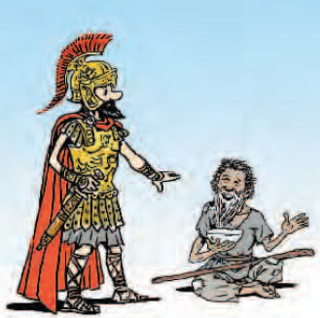
I heard you singing just now, and you sound very happy.
That’s because I am happy.

Slide 22
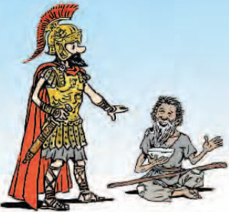
I have everything I want, and I don’t want what I can’t have. So I’m happy, and my song comes from the happiness in my heart.
But I don’t understand. What makes you so happy? You have no power, money or fame.

Slide 23
Then I need to give your shirt to the king. Is it there in your bag? How much do you want for it?
Shirt? What shirt? I don’t own any shirts!

Slide 24


永远保持快乐
寻找
remain happy forever
search for
句型
1. Two days passed.
2. What makes you so happy?
2. I have everything I want, and I don’t want what I can’t have.

Slide 25


Preview the article The Winning Team.

Slide 26


